Slide 1

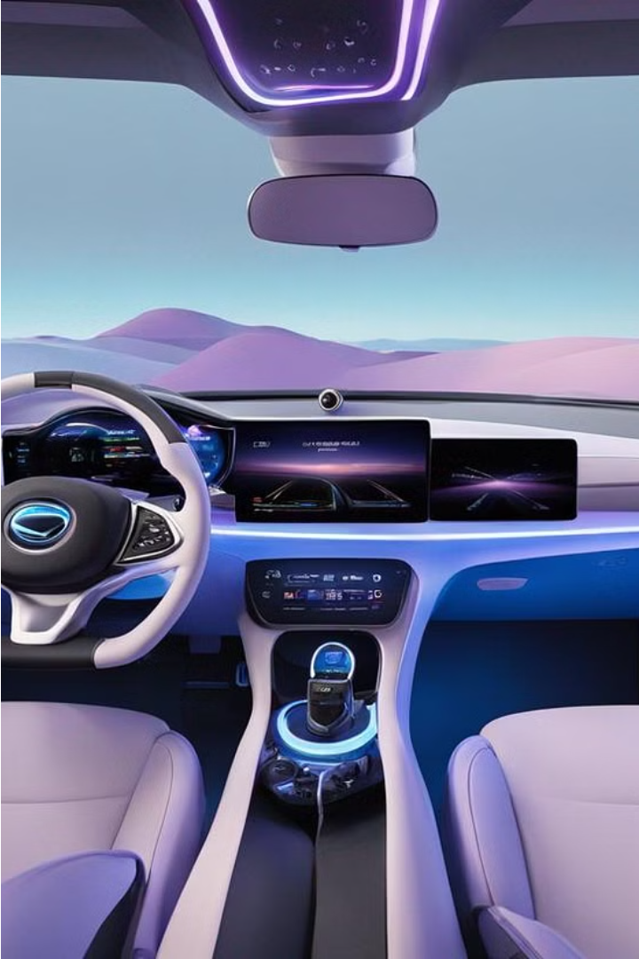




Design & Development of a Human-Agent Collaboration Model for Situation Awareness in Cockpit
by Yitong Hu

Slide 2

Table of Content
1
Background
2
My Solution: HCockpit & HCopilot
3
Design & Implementation
4
Demonstration
5
Conclusion and Future Work

Slide 3

Background
1
Autonomous Evolution
Evolutionary journey toward L5 autonomy
2
Oversight from Human
Necessity for human control
3
Human-Agent Collaboration
Enhancing driving experience and safty

Slide 4
Motivation
Improve UX
Improve Security
Driver perception enhancement
Complex tarffic conditions handling
Interactive cockpit functions
Low attention alerts
Autonomous preferences
Proactive threat alerts

Slide 5
My Solution:
HCockpit and HCopilot

Slide 6
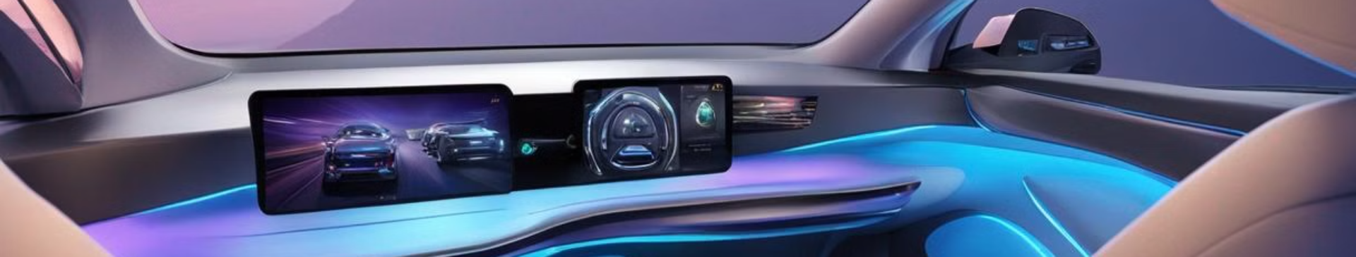
Design and Implementation
1
HCockpit Architecture
2
HCopilot Implementation

Slide 7
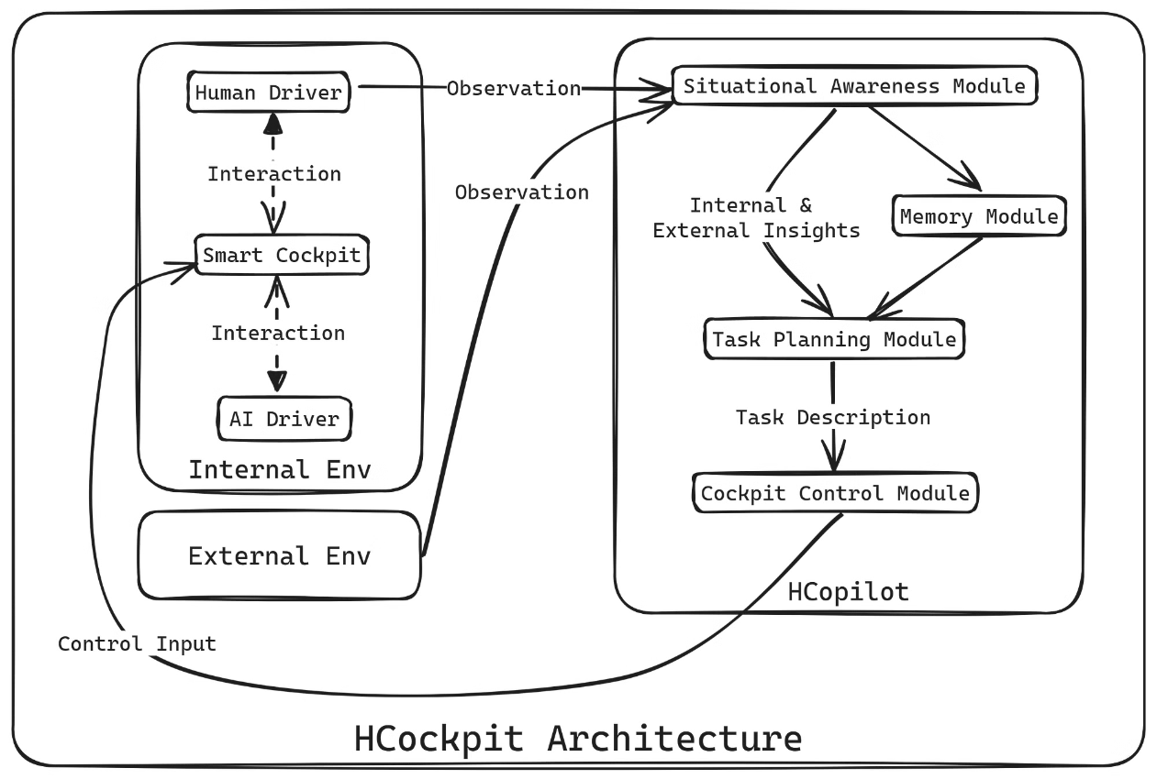
HCockpit Architecture

Slide 8

HCopilot Implementation
HCopilot is an agent developed following HCockpit architecture.

Slide 9
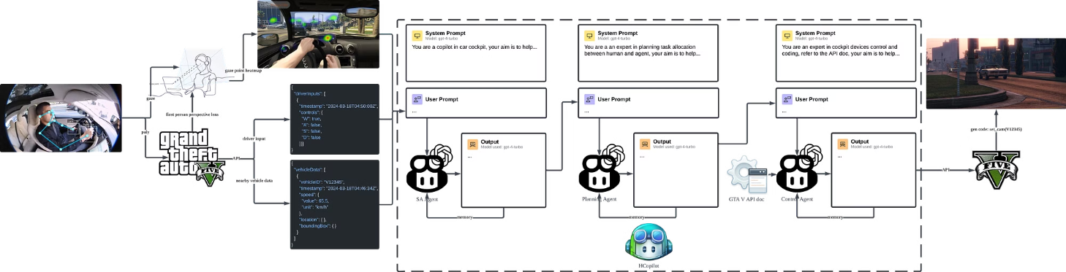
1. Pipeline

Slide 10
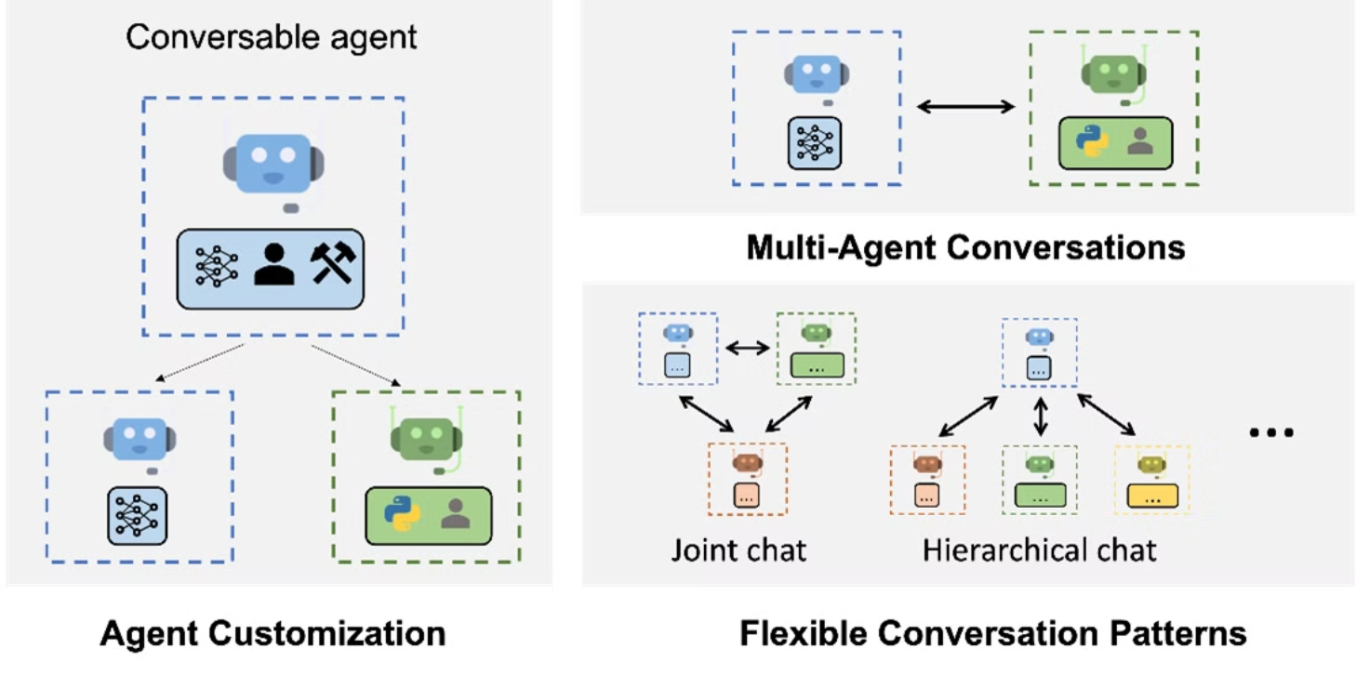
2. Multi-Agent System

Slide 11
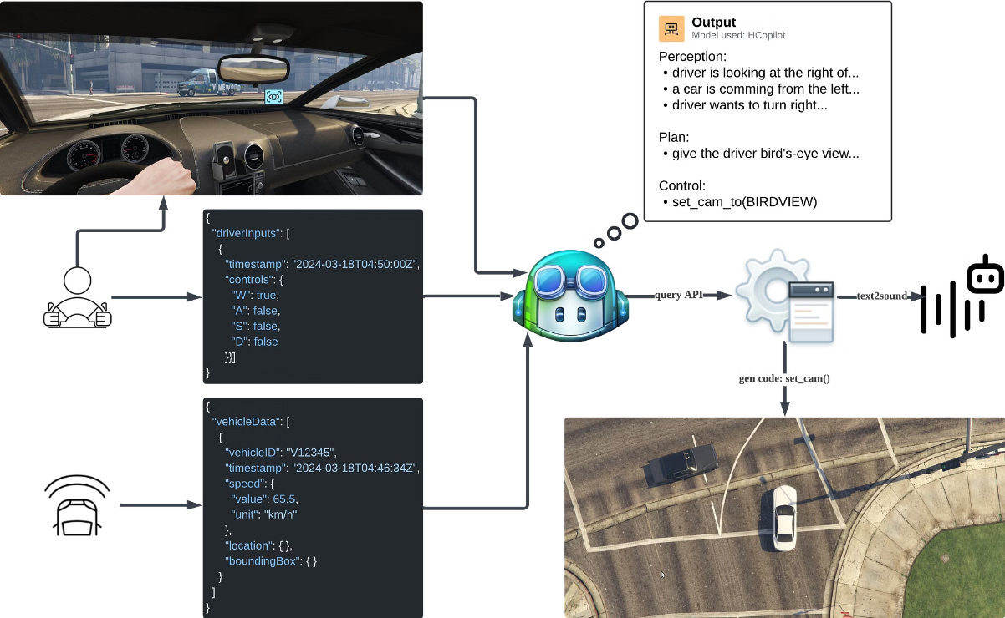
Demonstration
1. Driver Perception Enhancement Case: Trun Right

Slide 12
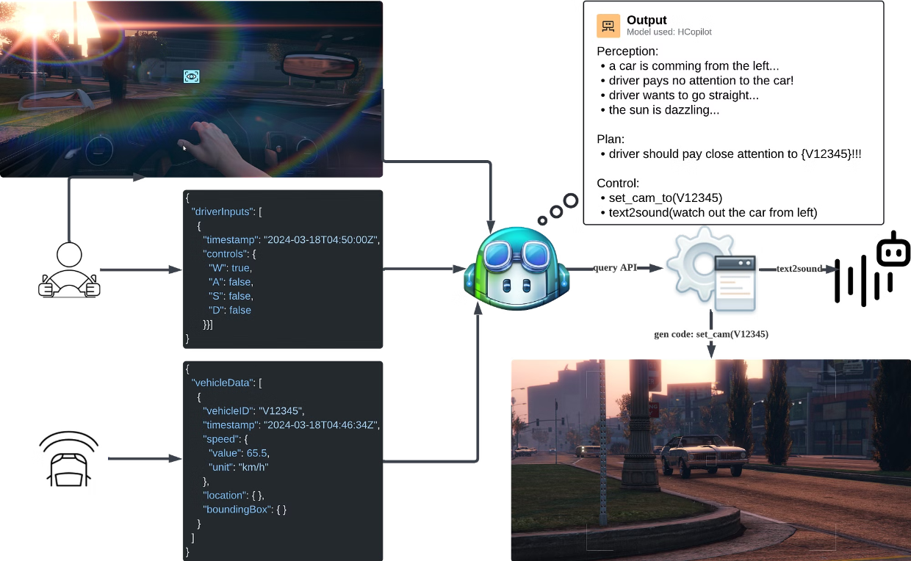
2. Proactive Threat Alerts Case: Too Bright to See

Slide 13
Conclusion and Future Work
Conclusion
Future Work
Explainable decision-making helps enhance human-machine trust
Improve entity alignment between different perspectives
The gaze points and body movements of the human contain rich hidden information
Gaze point embedding
Run large models locally in real time
LLMs have strong zero-shot learning ability

Slide 14

Thank You

